Slide 1
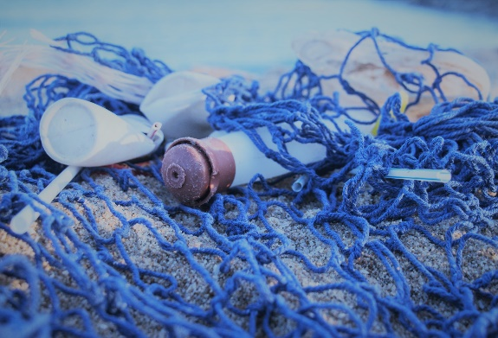

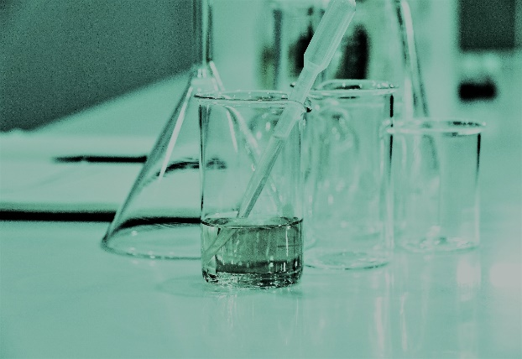
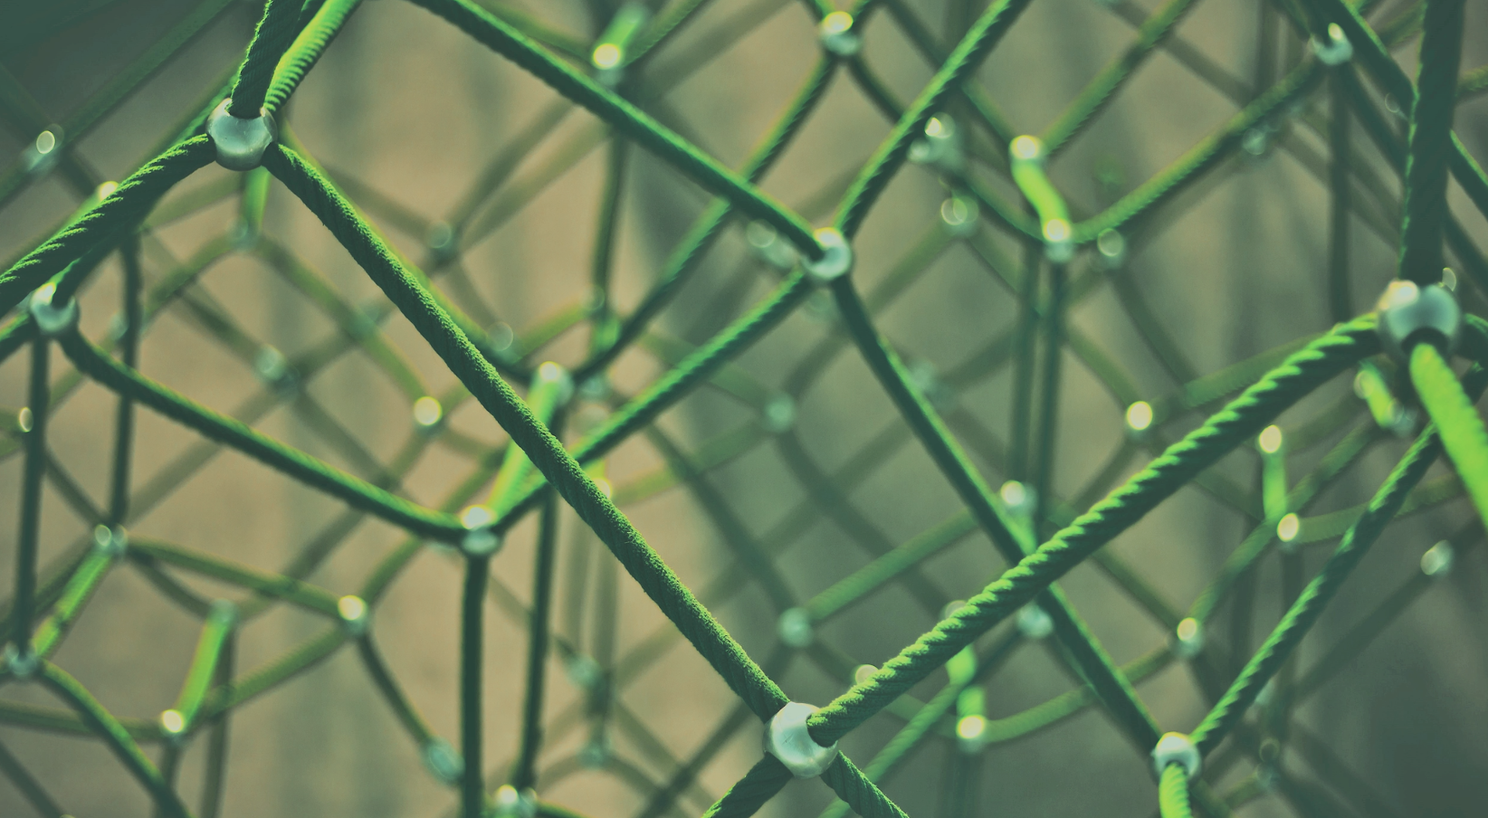
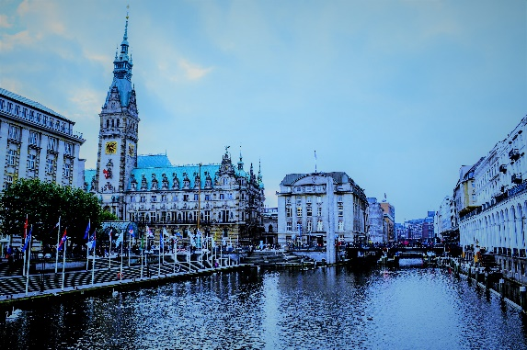
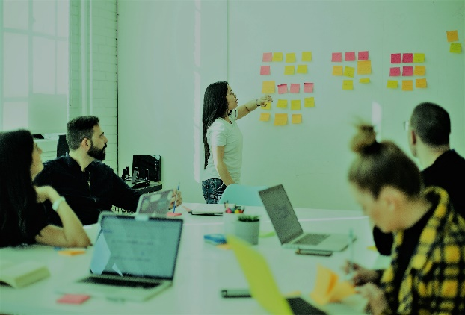
European Bioplastics Research Network
“TECHNOLOGICAL AND MARKET - RELATED CHALLENGES TO BIO-BASED PLASTICS PRODUCTION”
3rd EBRN Virtual Meeting
17th February 2021
10.00h-12.00h
THE EVENT WILL BE RECORDED
This project has received funding from the European Union’s Horizon 2020 research and innovation programme under grant agreement No. 860407

Slide 2
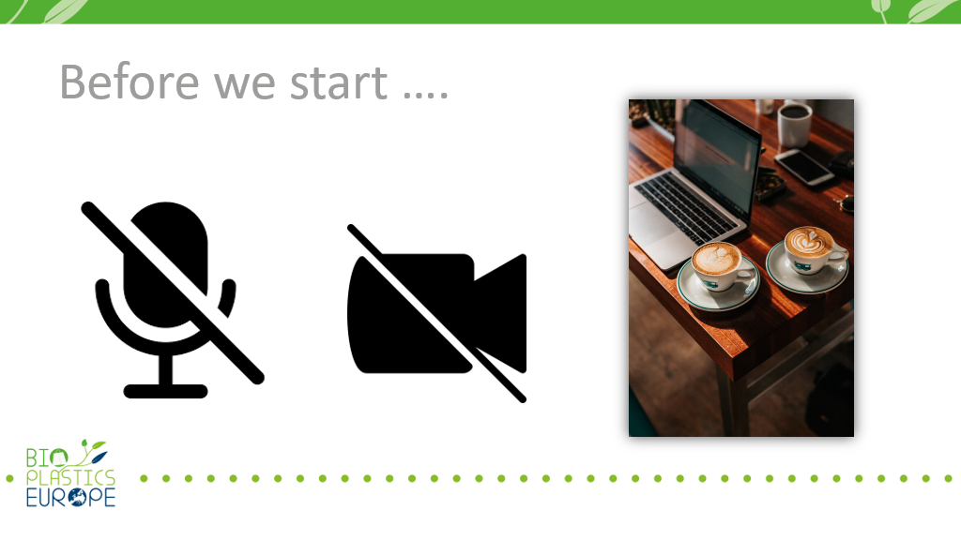

Slide 3
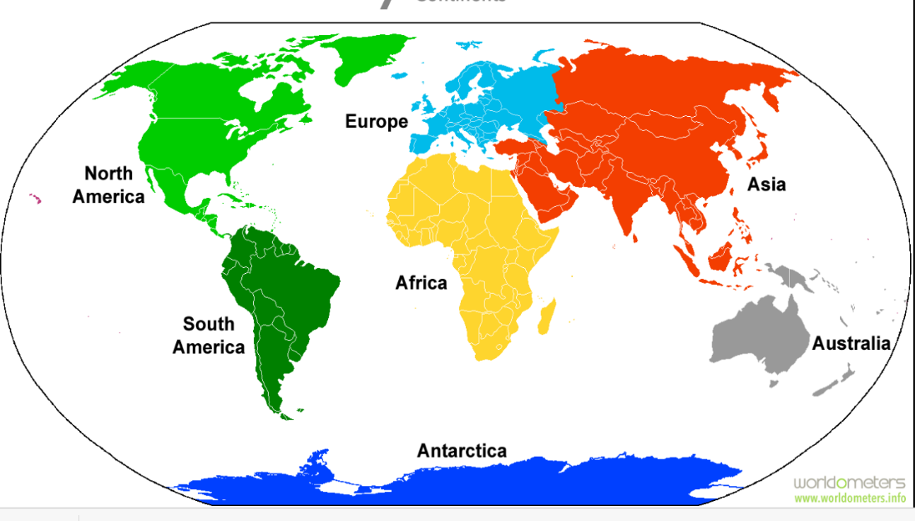
Distribution of the participants
27 countries
91
8
1
6
1
3

Slide 4
Programme
Start | Agenda item | Speaker | Institution
10:00 | Opening of the meeting | Dr. Jelena Barbir | Hamburg University of Applied Sciences, DE
10:05 | Introduction to the BIO-PLASTICS EUROPE project | Dr. Jelena Barbir | Hamburg University of Applied Sciences, DE
10:15 | Technological challenges to bio-based plastics production | Athanassia Athanassiou | Italian Institute of Technology, IT
10:30 | Market-related challenges to bio-based plastics production | Oliver Buchholz | European Bioplastics e.V., DE
10:45 | Survey Online and short break
EXPERIENCE FROM THE EU COMPANIES
11:00 | Future prospects for bio-based and biodegradable plastics and their place in the market | Ari Rosling | ABM, FI
11:15 | Natureplast’s experience: Adequacy between possibilities and market expectationS | Laurent Belard | NATUREPLAST, FR
11:30 | Experience from VENVIROTECH | Patrica Ayma | VENVIROTECH, ES
Panel Discussion
11:45 | Joined Discussion of the survey outcomes | / | /
12:00 | Final remarks & closure | Dr. Jelena Barbir | Hamburg University of Applied Sciences, DE

Slide 5

HAW HAMBURG Coordinator
Presented by: Dr. Jelena Barbir
(Lead Project Manager)
This project has received funding from the European Union’s Horizon 2020 research and innovation programme under grant agreement No 860407. BIO-PLASTICS EUROPE project website: www.bioplasticseurope.eu

Slide 6
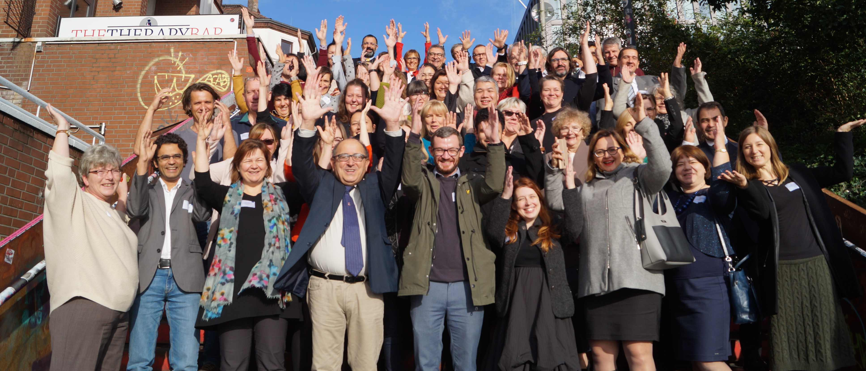
6
BIO-PLASTICS EUROPE
Developing and Implementing Sustainability-Based Solutions for Bio-Based Plastic Production and Use to Preserve Land and Sea Environmental Quality in Europe
October 2019 – September 2023
Project kicked-off in October 2019

Slide 7
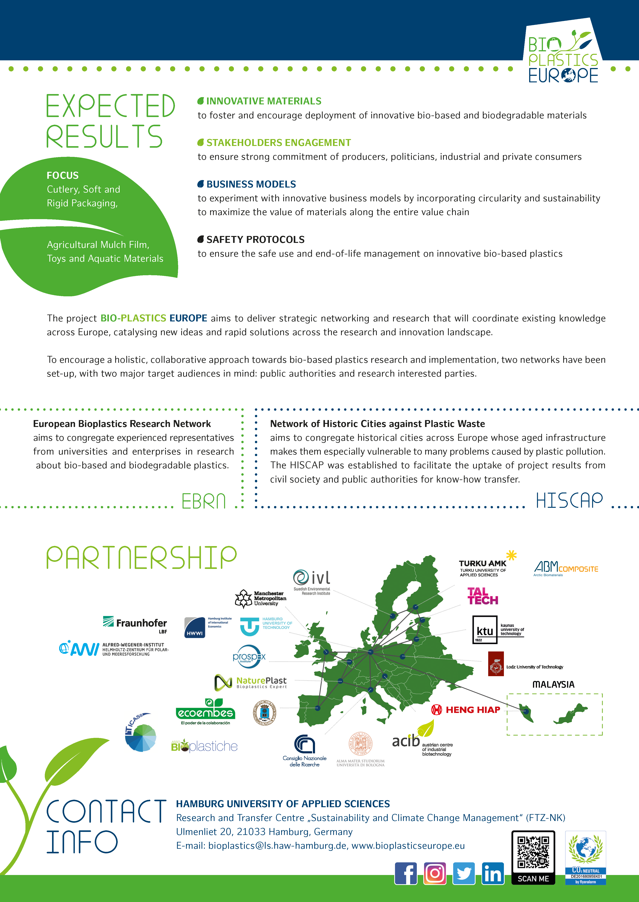
22 partners
13 countries
8.5 million Euros

Slide 8
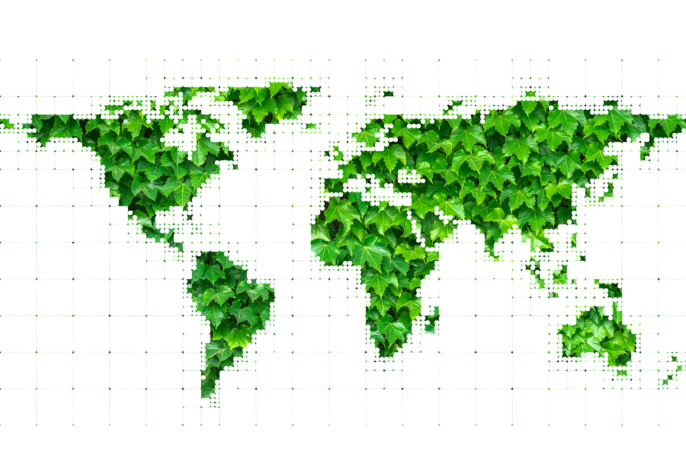
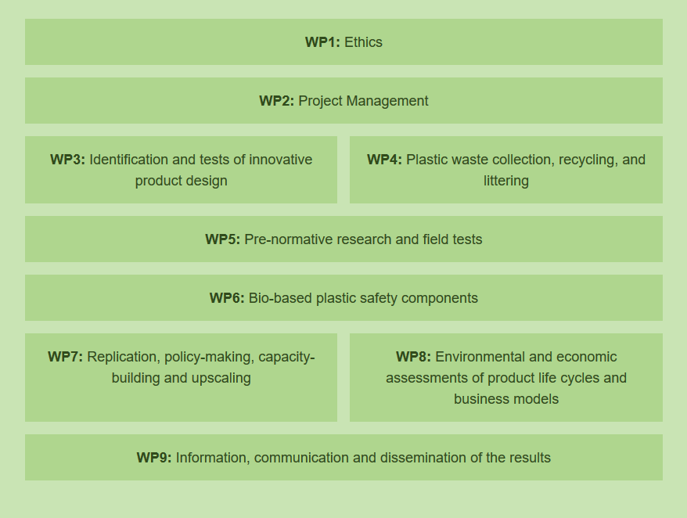
The main objective:
To develop sustainable strategies and solutions for bio-based plastic products, as well as the to develop approaches focused on circular innovation for the whole bioplastics system. These may be deployed to support policy-making, innovation and technology transfer.
Objective 1:
To define, test and deploy innovative product design strategies + made from renewable sources + transformation of current/creating new bio-based products
WP3
Objective 2:
To map current waste collection and management schemes + addressing technical and economic barriers to bio-based plastics recycling
WP4
Objective 3:
To investigate the potential impacts of bio-based plastics on the terrestrial and aquatic environments + possible implications to human health.
WP 5 & 6
Objective 4:
To build a biodegradable plastics sustainability framework + to produce “safety protocol”
WP6
Objective 5:
To develop Innovative Business Models
WP7 and WP8
Objective 6:
Communication Strategy
+ cooperative knowledge sharing of Best Practices and Lessons Learned
WP9

Slide 9
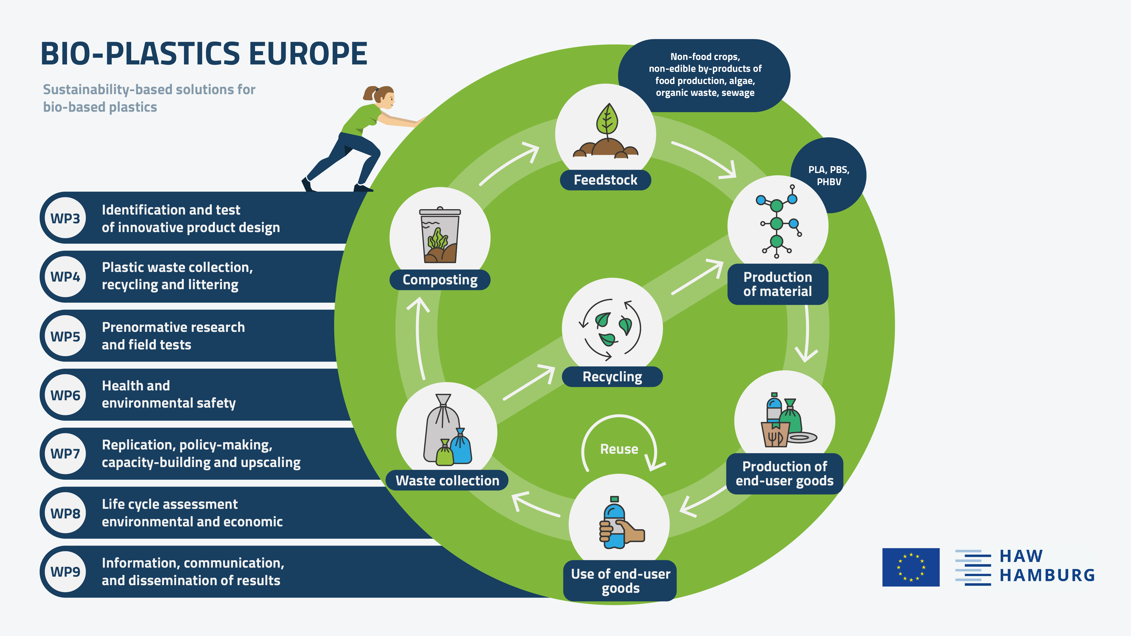
Pushes towards circular economy

Slide 11
Where we stand now….
Phase 1
Introduction and Analysis
(M1-M6)
Phase 2
Research, development and Implementation
(M7-M40)
Phase 3
Upscaling and Replication
(M41-M48)
Within the BIO-PLASTICS EUROPE project, the following end-products are experimented:
- PACKAGING (rigid and flexible)
- TOYS
- AGRICULTURAL MULCH FILM
- CUTLERY
- AQUATIC MATERIALS: geo-membrane, fishing baits, fishing cradles
First group of 5 materials developed

Slide 12
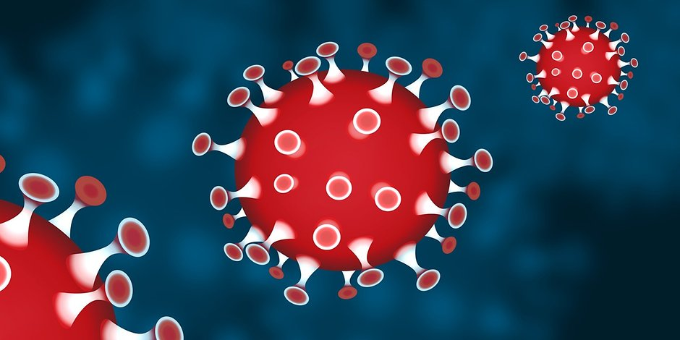
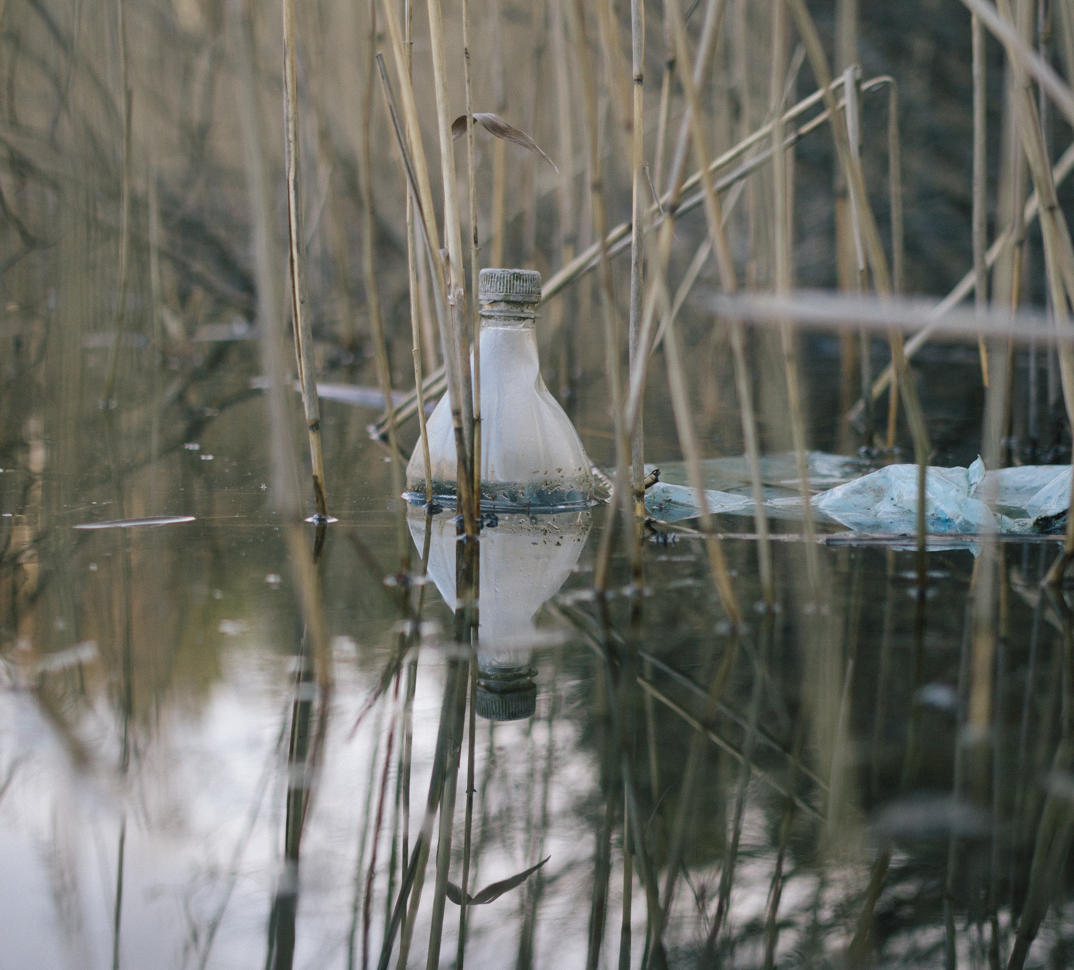
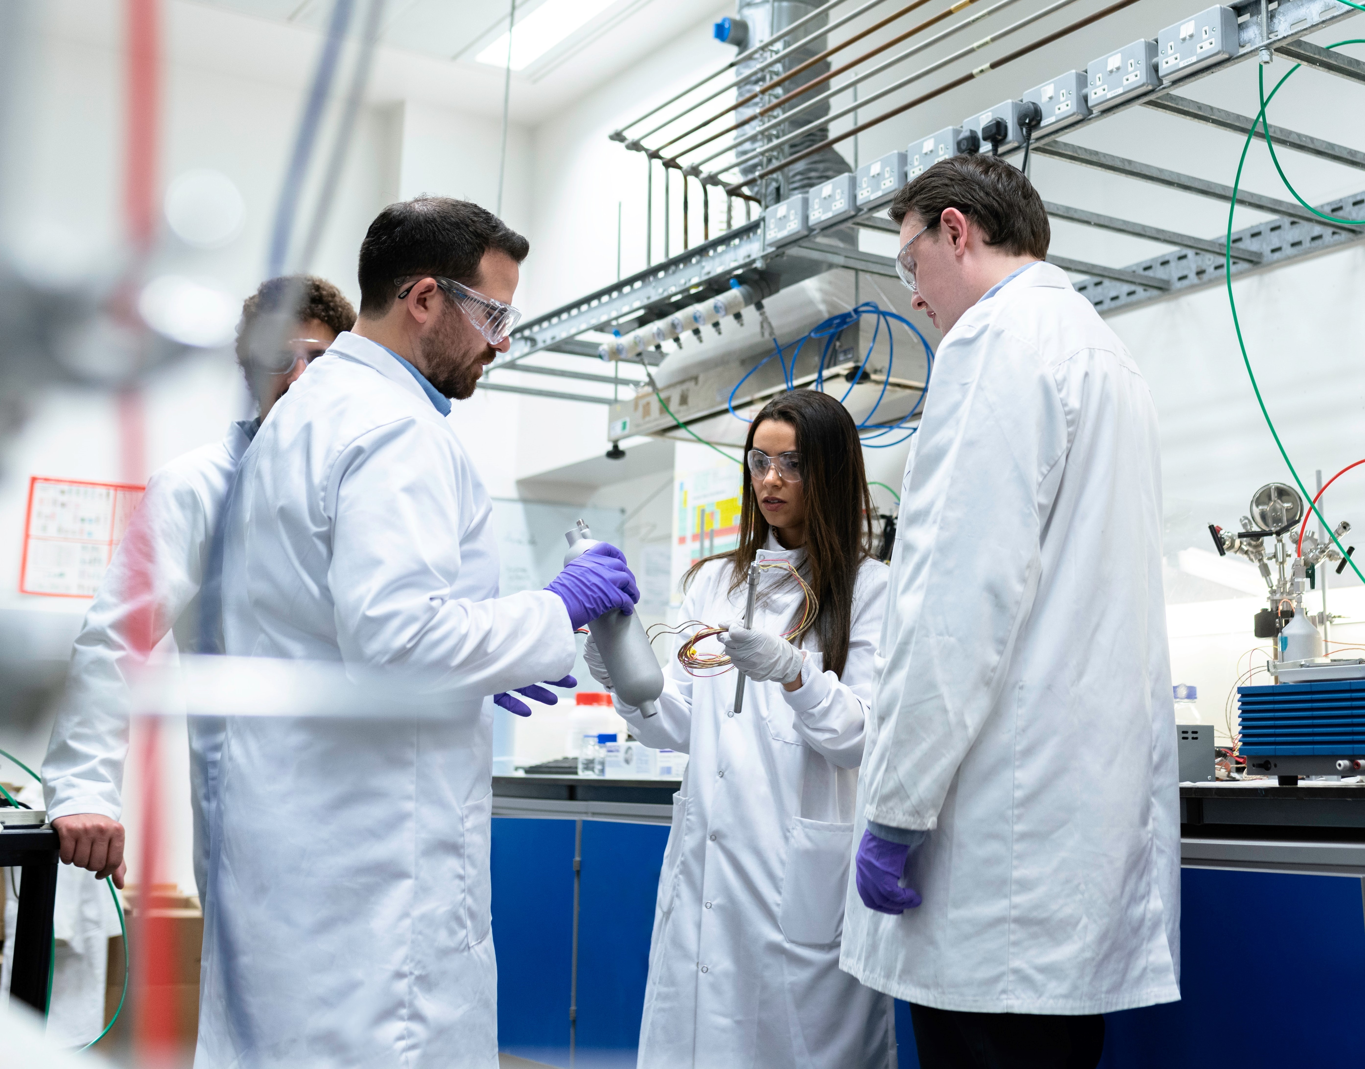
5 MATERIALS:
The materials under investigation are:
BPE-FP-PBS
BPE-RP-PLA
BPE-T-PHBV
BPE-AMF-PLA
BPE-C-PLA
SENT FOR LABORATORY AND FIELD TESTS
Samples prepared-received
Test Protocols finished
Tests started 1st of September
First preliminary results obtained
From this list mainly PLA is already commercially in use and well available according to very recent application notes from various companies.
MODIFICATION of the materials after 1st round tests
2nd round of TESTS

Slide 13
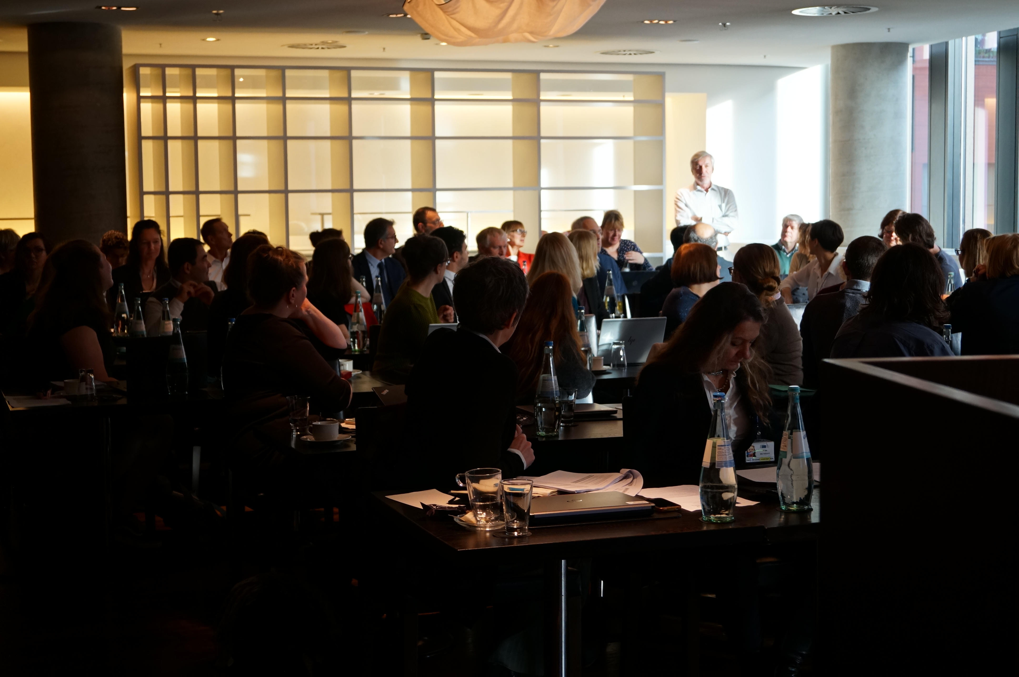
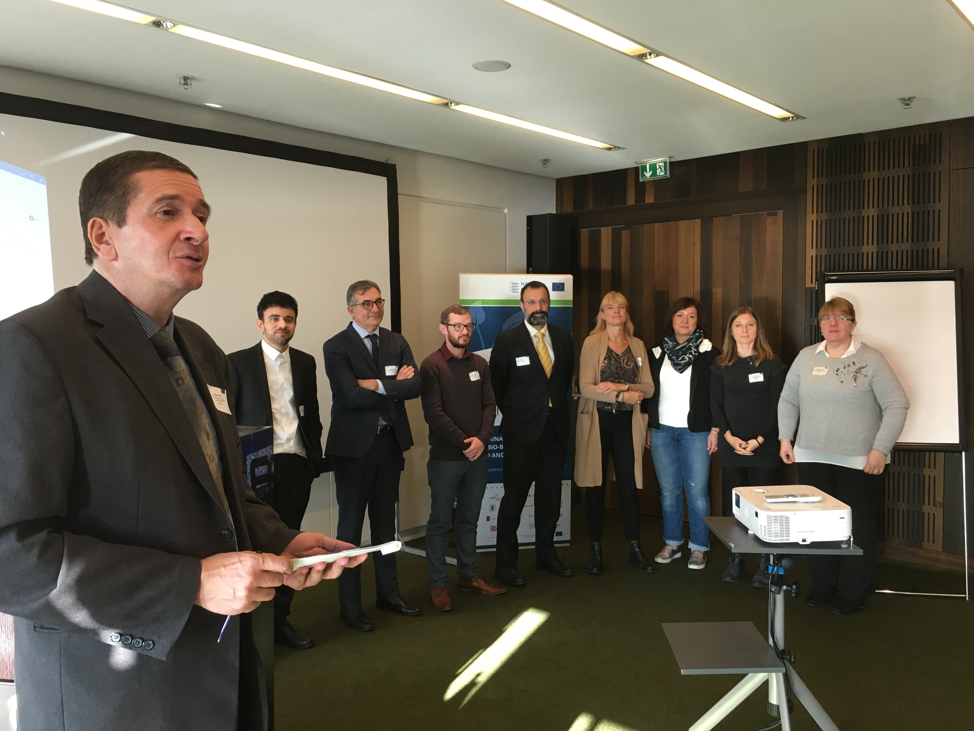
Besides focusing on research….

Slide 14
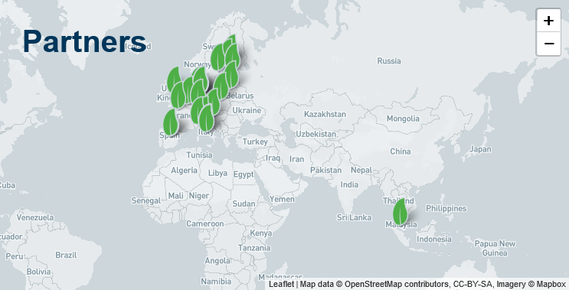
STAKEHOLDER ENGAGEMENT
12 ONLINE STAKEHOLDER PROMOTION EVENTS
September 2020 – January 2021
PROMOTE PROJECT
CLUSTER stakeholders
FUTURE INVOLMENT

Slide 15
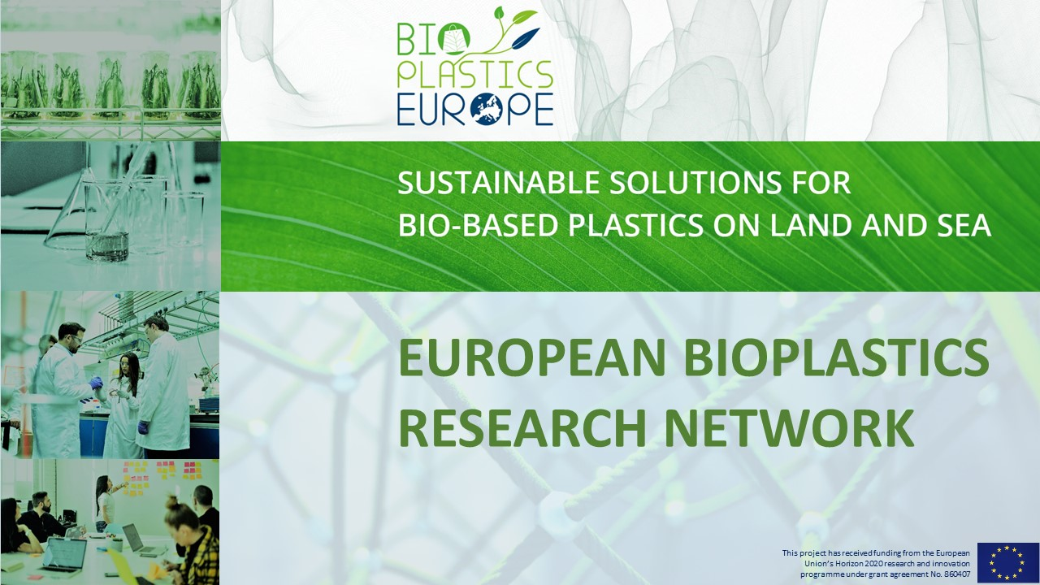
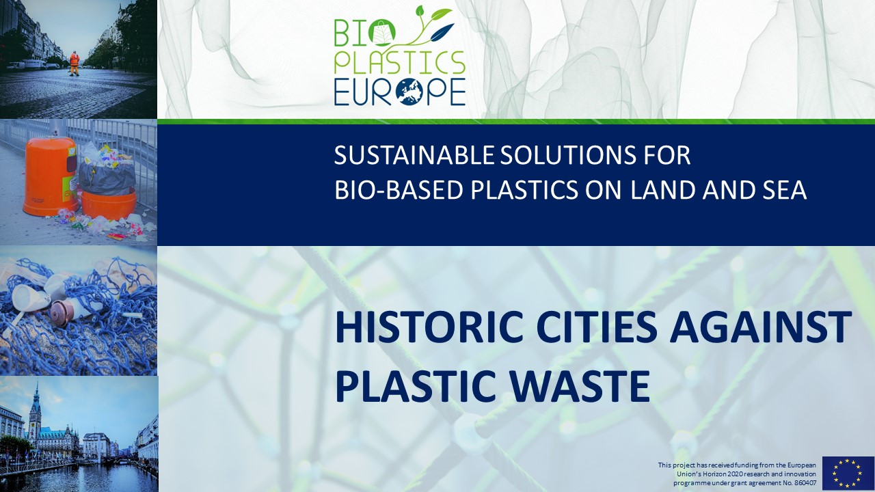
NETWORKS
3nd event 17th of February
1st WORKSHOP24th of February
Connect cities
Preparing events
Exchange experience
Offer solutions
LinkedIn: over 330 members
Preparing events
Foster communication
Share experience

Slide 16
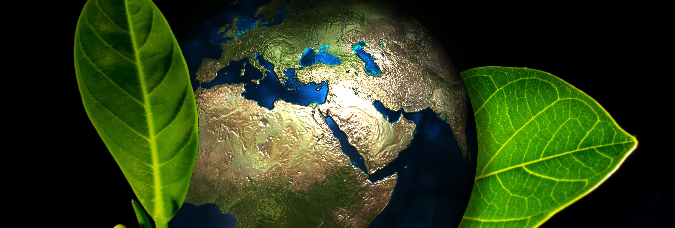

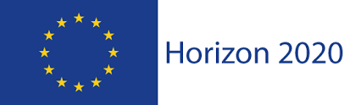
THANK YOU FOR ENGAGING WITH US…..
HAMBURG UNIVERSITY OF APPLIED SCIENCES
Research + Transfer Centre „Sustainability & Climate Change Management“ (FTZ-NK)
Ulmenliet 20 / 21033 Hamburg / Germany
T +49 40 428 75 6362 (Mon - Fri 8AM-3PM)
Email: bioplastics@ls.haw-hamburg.de
Website: https://bioplasticseurope.eu/
…… THANK YOU FOR YOUR ATTENTION!

Slide 17
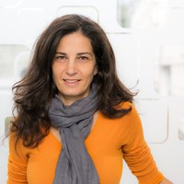

European Bioplastics Research Network
NEXT SPEAKER
Athanassia Athanassiou
Italy

Slide 18
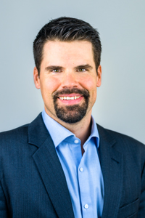

European Bioplastics Research Network
NEXT SPEAKER
Oliver Buchholz
Germany

Slide 19
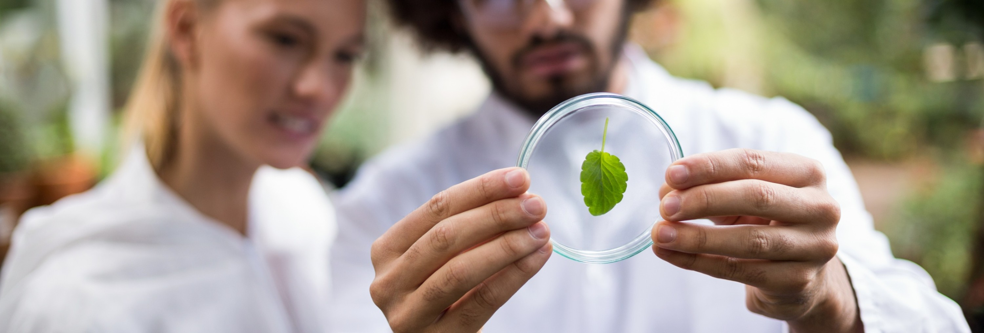
Market-related challenges
to bio-based plastics production
1
Oliver Buchholz, Communications Manager, European Bioplastics (EUBP)
3rd EBRN Event | 17 February 2021 | Online
………………………………………................................

Slide 20



















Members of European Bioplastics – The value chain*
2
Renewable raw materials / Green chemistry Certification
Bioplastics manufacturers and auxiliaries
Converters
Brand owners
Research
*selection of EUBP members in 2021

Slide 21
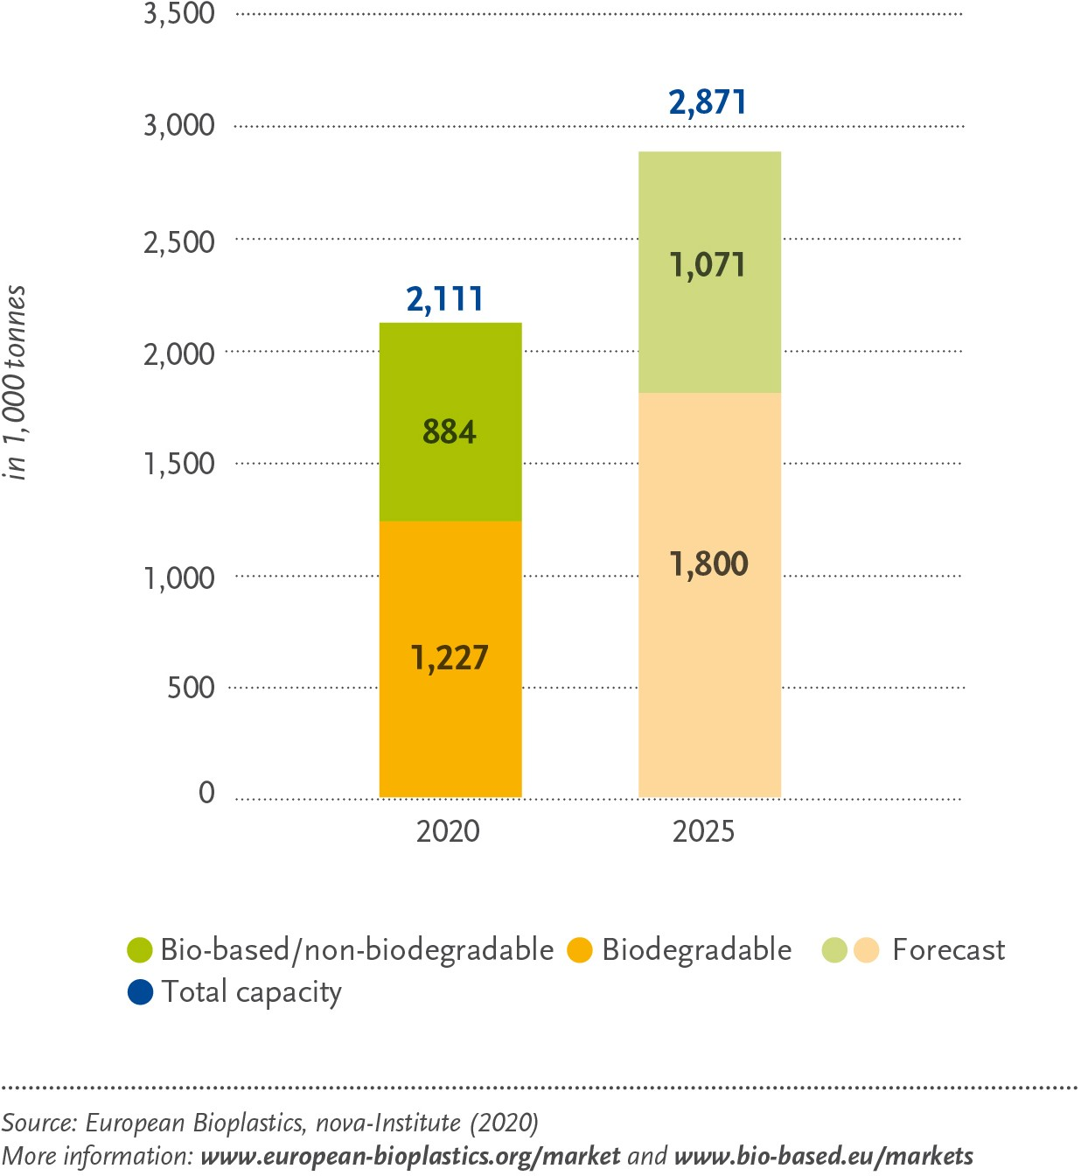
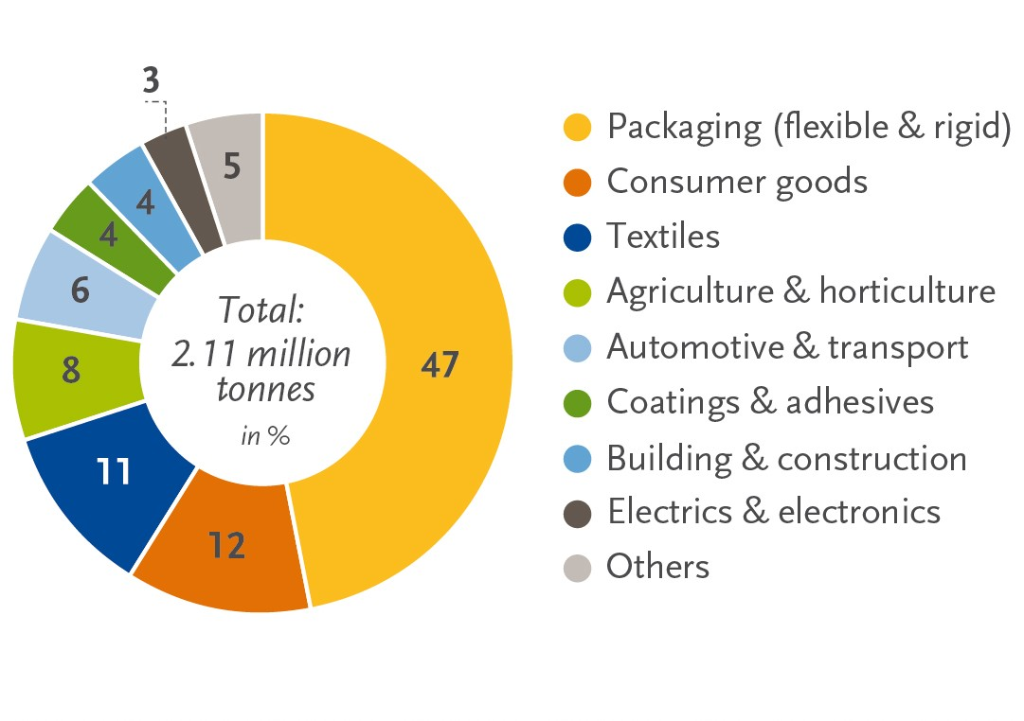
Global production capacities and market segments 2020
3

Slide 22
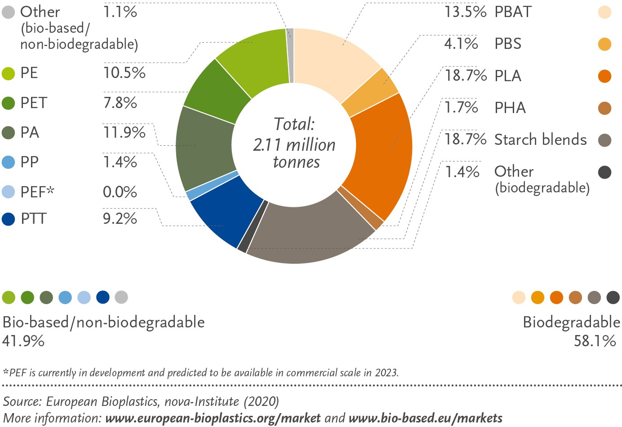
4
Global production capacities by material type (2020)

Slide 23
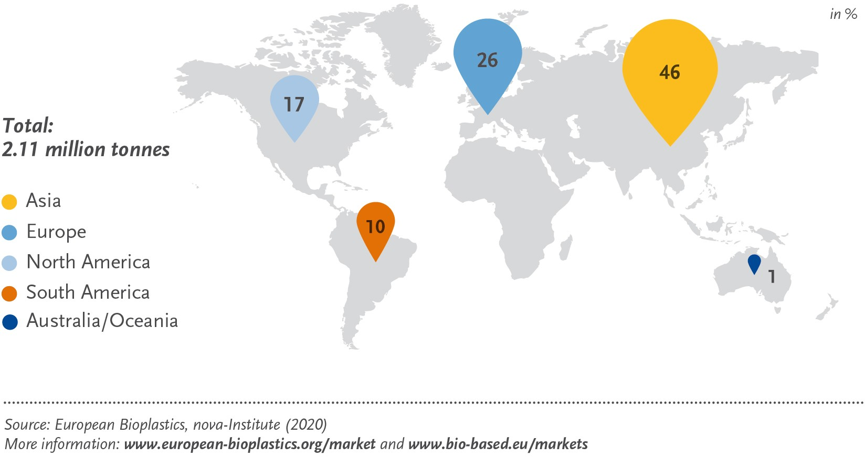
5
Regional development of production capacities 2020

Slide 24
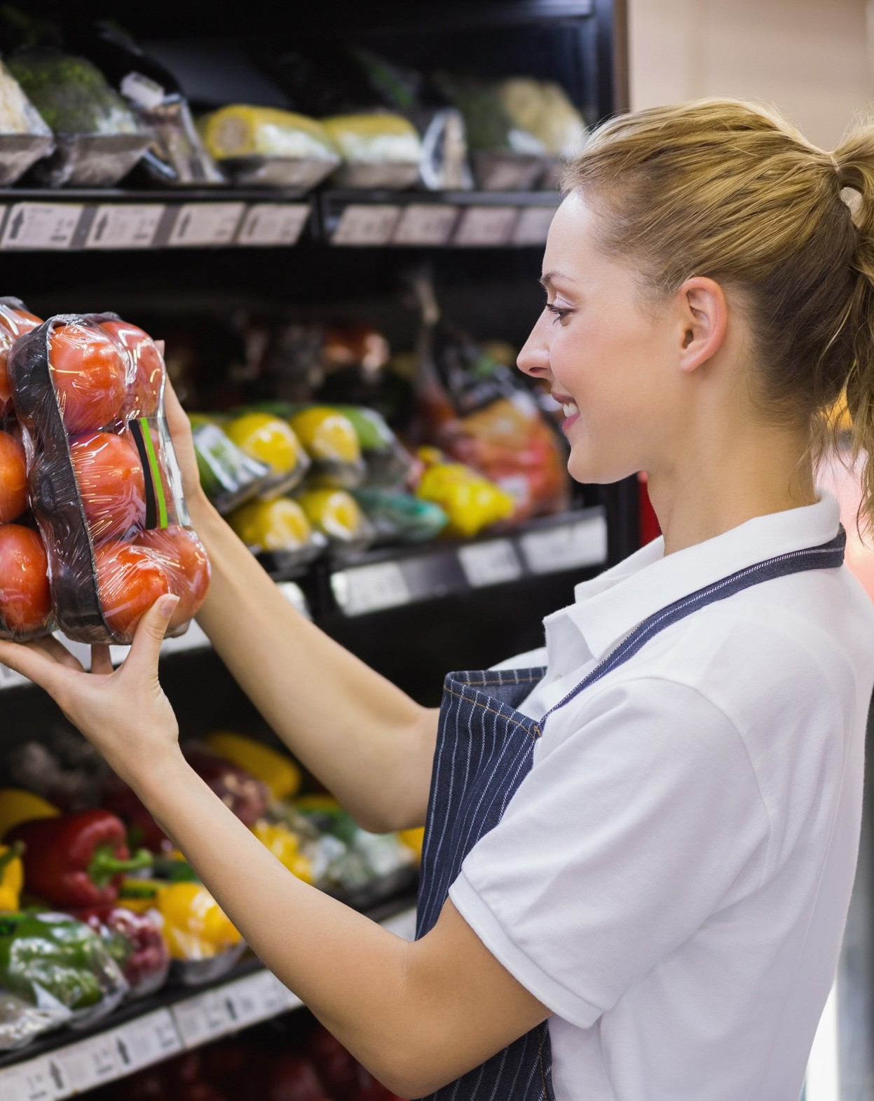
Market drivers and barriers
6
Market drivers
Innovation (advanced technical properties and functionalities)
Market demand and high consumer acceptance
Sustainability and environmental impacts
Recyclability and new recycling options
Renewability and therefore independence from fossil resources

Slide 25
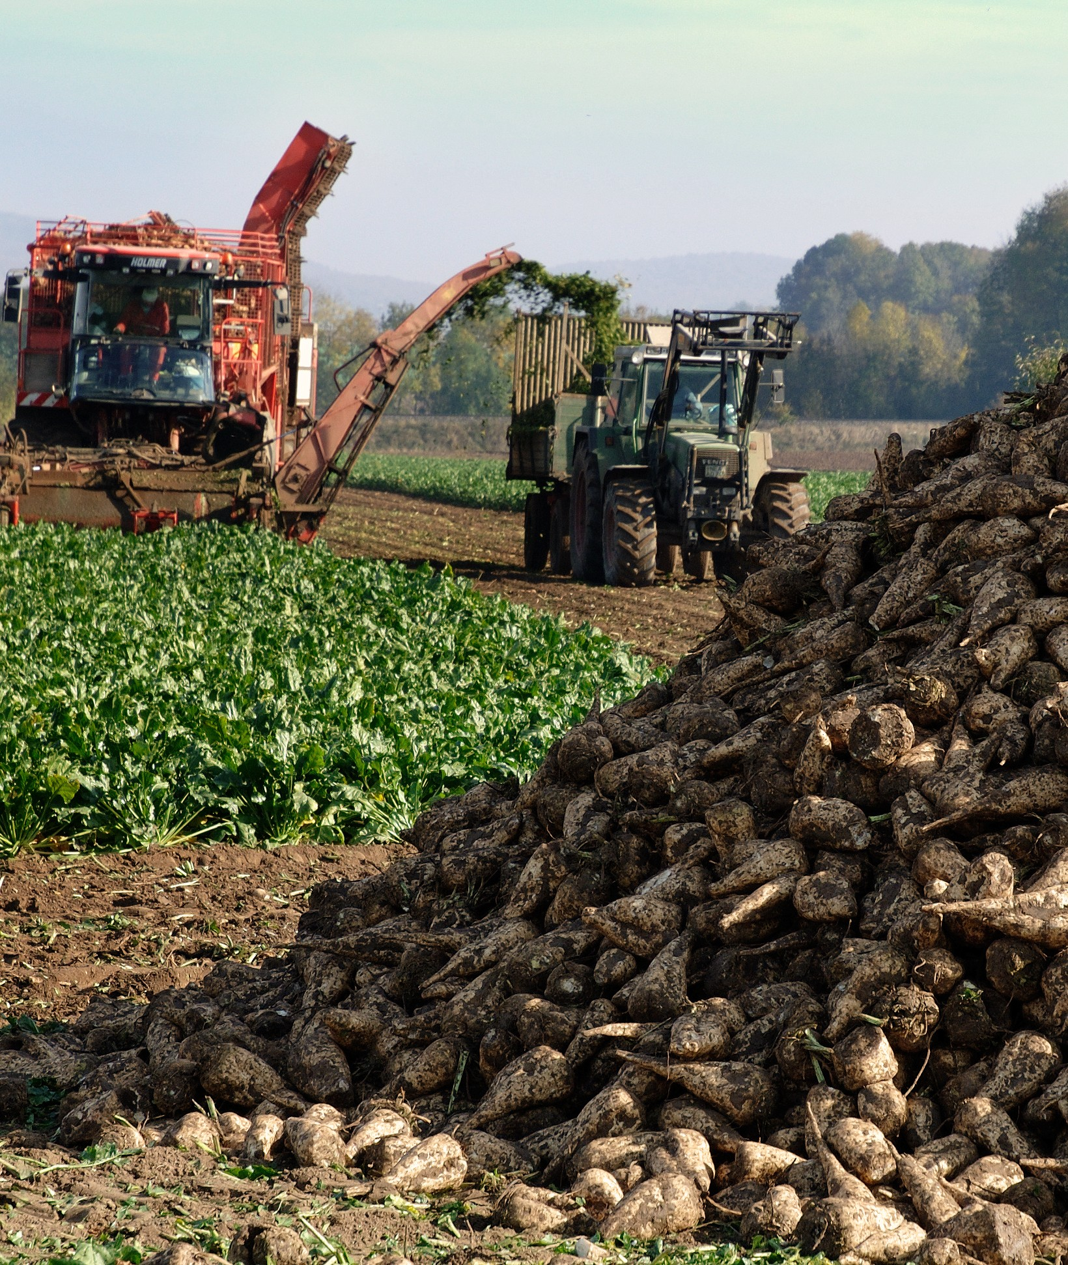
Market drivers and barriers
7
Market barriers
Level playing field needed for all bio- based industries to ensure access to biomass
Acceptance in established waste streams
No policy framework, measures, such as quotas exist for renewable energy sector, but not for bioplastics
Missing links between suppliers of raw materials and manufacturers
Lack of knowledge and complexity
regarding communication

Slide 26
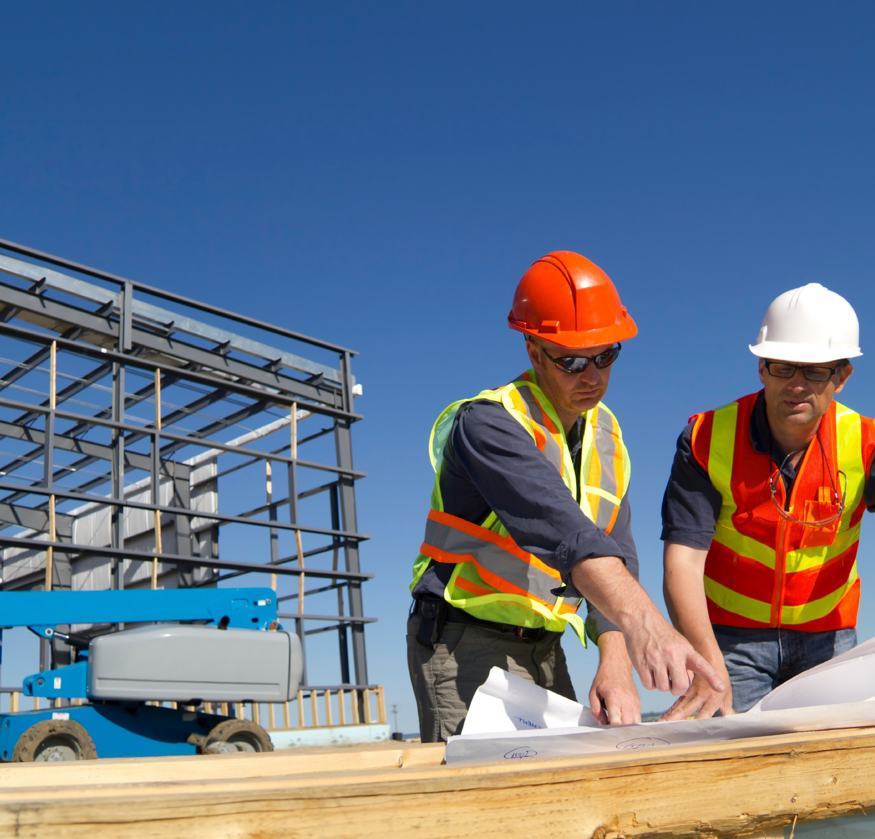
Market trends and the Covid-19 pandemic
8
Covid-19 crisis led to decrease of both oil price and and GDP
Need for heath-safe packaging and demand for personal protective equipment (e.g. face masks/gloves)
Shift of social awareness regarding the use of plastics
No studies on the real reflects on the demands of bioplastics after the pandemic
No shift or change in the industry during 2020

Slide 27
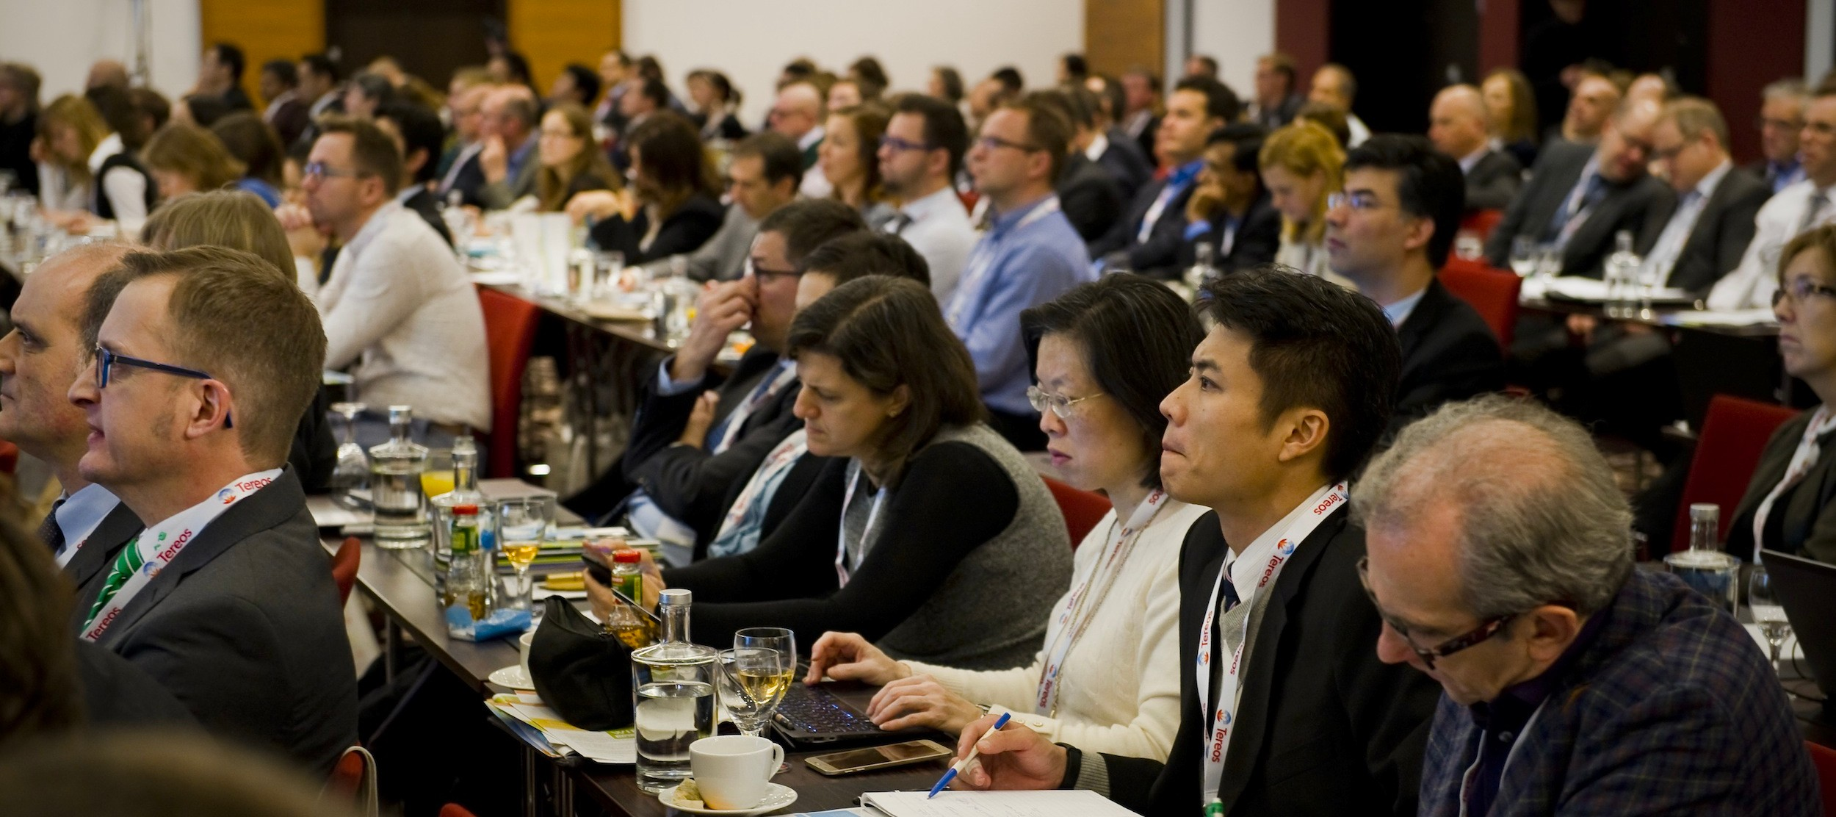
16th EUBP Conference – Berlin, 30 November/1 December 2021
9
SAVE THE DATE!
More information on www.european-bioplastics.org/events/eubp-conference/

Slide 28
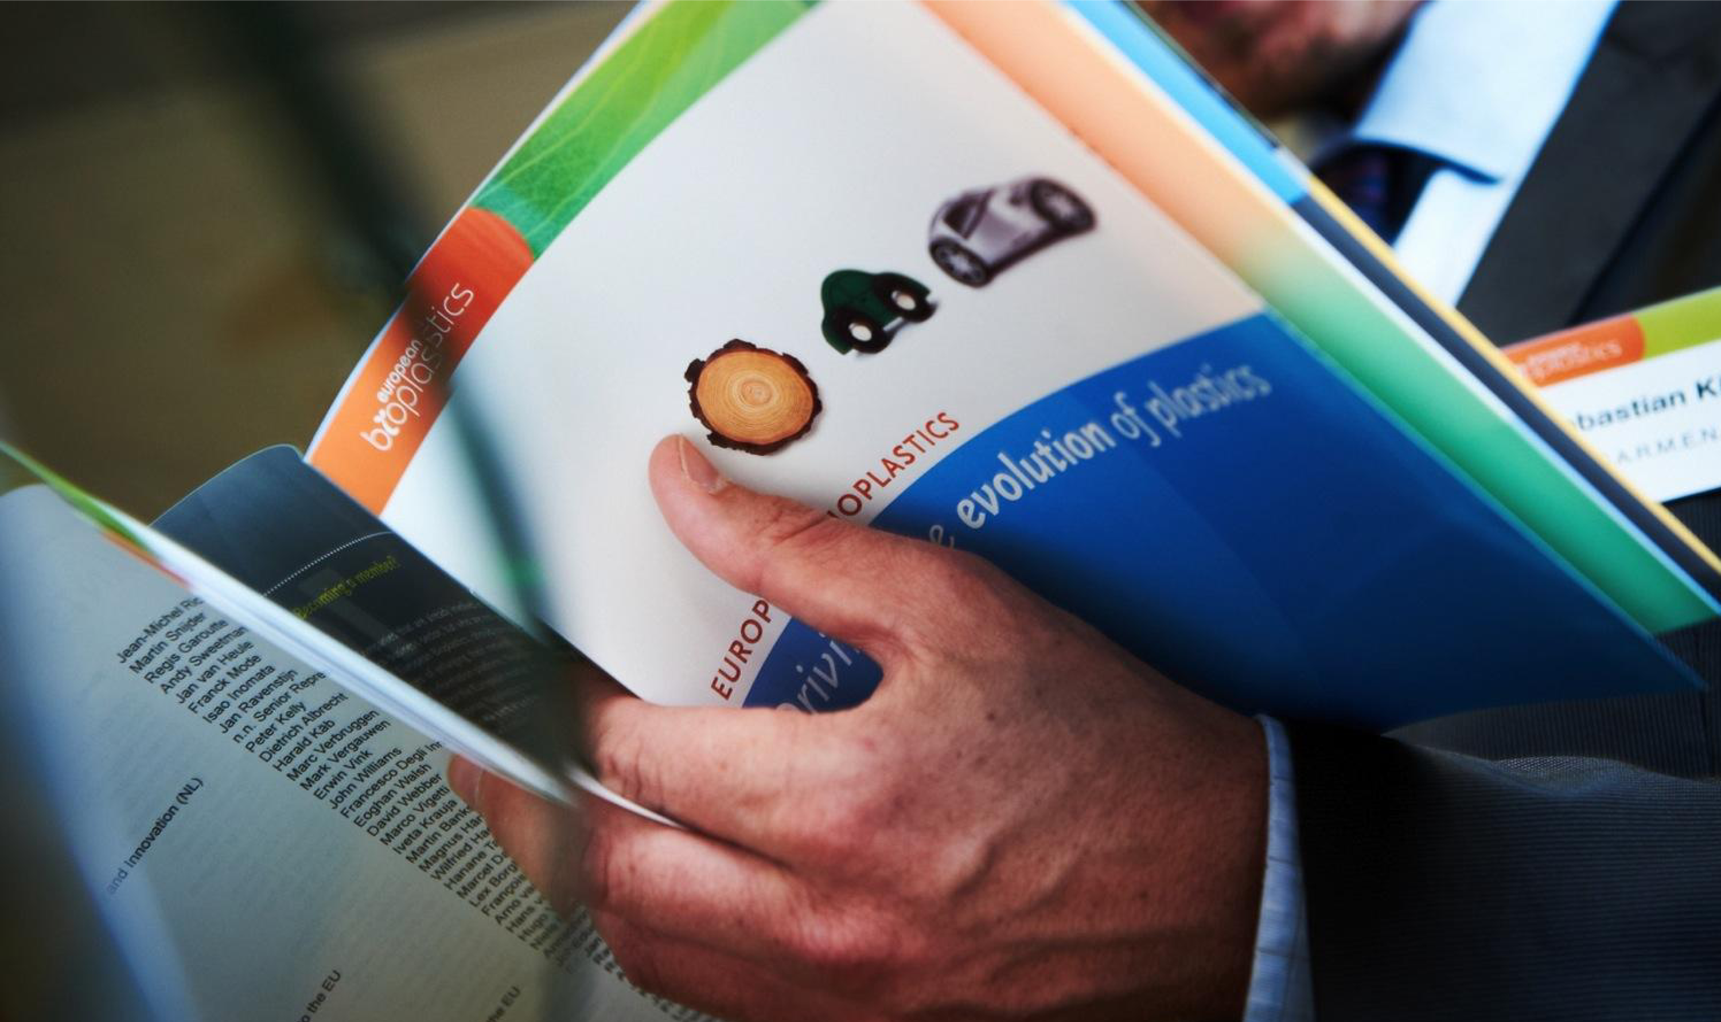
Thank you!
10
European Bioplastics e.V.
Marienstr. 19-20, D- 10117 Berlin (Mitte)
Phone. +49 (0) 30 28482 350
Fax +49 (0) 30 28482 359
info@european-bioplastics.org
http://www.european-bioplastics.org http://twitter.com/EUBioplastics

Slide 29

“TECHNOLOGICAL AND MARKET RELATED CHALLENGES
TO BIO-BASED PLASTICS PRODUCTION”
ONLINE SURVEY
Follow us on social media
BIO-PLASTICS EUROPE website: https://bioplasticseurope.eu/
European Bioplastics Research Network
This project has received funding from the European Union’s Horizon 2020 research and innovation programme under grant agreement No. 860407

Slide 30
“TECHNOLOGICAL AND MARKET RELATED CHALLENGES
TO BIO-BASED PLASTICS PRODUCTION”
Experience from the EU Companies
European Bioplastics Research Network
This project has received funding from the European Union’s Horizon 2020 research and innovation programme under grant agreement No. 860407

Slide 31


European Bioplastics Research Network
NEXT SPEAKER
Ari Rosling
Finland

Slide 32
32
Future prospects for bio-based and bio-degradable plastics and their place in the market
Arctic Biomaterials (ABM)
R&D Director Ari Rosling
3rd EBRN event
“Technological and market-related challenges to bio-based plastics production”
17th of February 2021
This project has received funding from the European Union’s Horizon 2020 research and innovation programme under grant agreement No 860407. BIOPLASTICS EUROPE project website: www.bioplasticseurope.eu

Slide 33
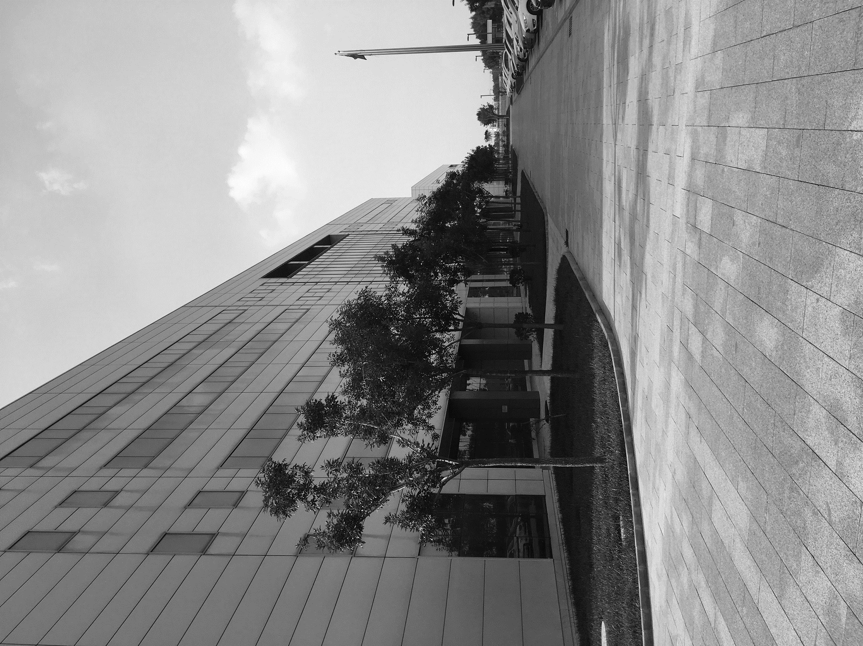
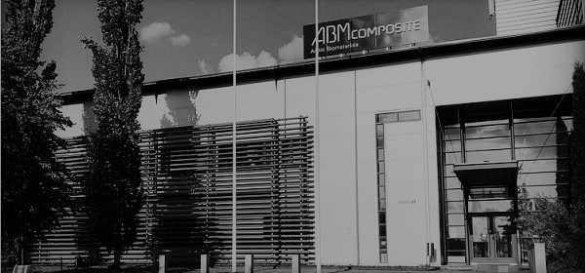
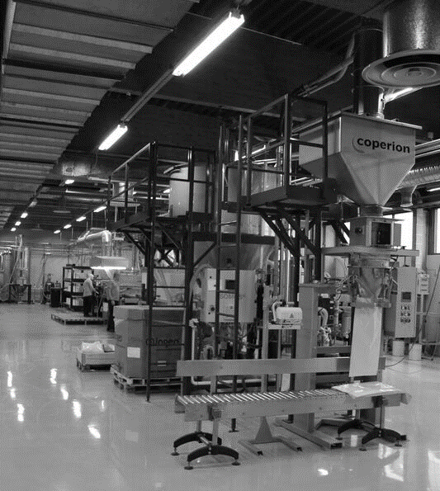
33
General Company info
Founded in 2014
60 specialists with extensive biopolymer experience
Medical & Technical product manufacturing and R&D sites at Tampere, Finland + new R&D and manufacturing site in Asia
Arctic Biomaterials (ABM)
HQ
Tech
site
CN

Slide 34
Bioplastics supply-chain
ABM
Agriculture
Starch/sugar refinery
Monomer production
Polymer production
Compoun-ding
Plastic conversion
Brandowner
Retailer
Consumer

Slide 35
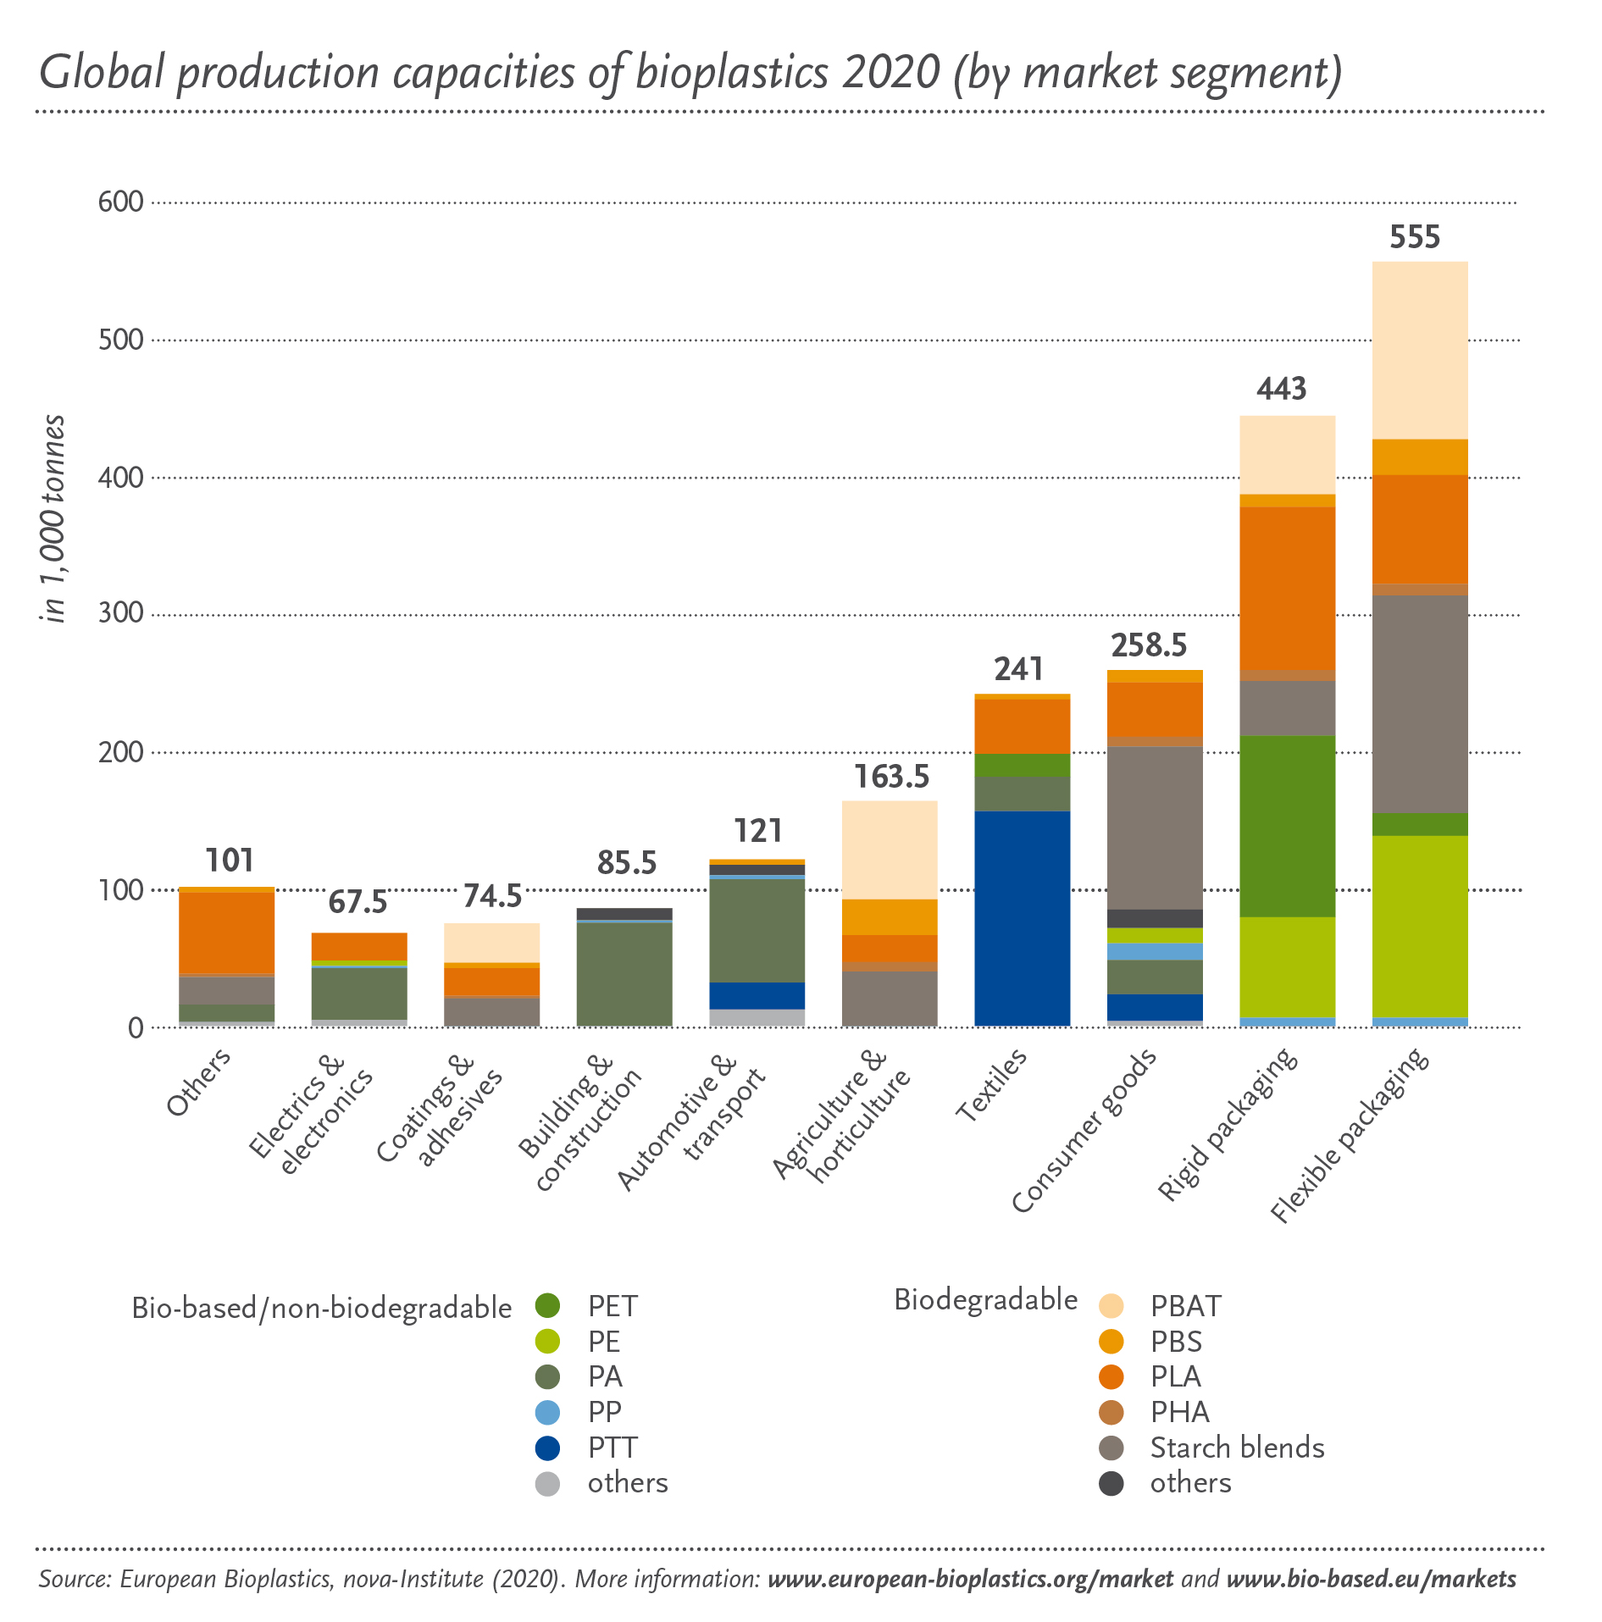
Bioplastics and market segments
Growth potential
Material functionality
The application area place specific requirements on the material performance and properties

Slide 36
Bio-based biodegradable plastics
Benefits and Challanges
Drivers
Barriers
Decoupling from fossil resources
Environmental aspects
  Production less energy demanding
  Reduced carbon footprint
  Address the littering problem
  Utilisation of various biomass & waste streams for polymer production
Materials with improved performance
Positive perception/image
  Brandowners’ sustainability policies
  Consumer awareness
Regulative & economical incentives
The bioplastic space is confusing
  Misleading information
Uncertainty in functional performance
Incompatiblity with present process equipment
Availability (raw materials & compounds; feedstock issues)
Uncertainty about future legislation
Regulatory requirements
Expensive

Slide 37
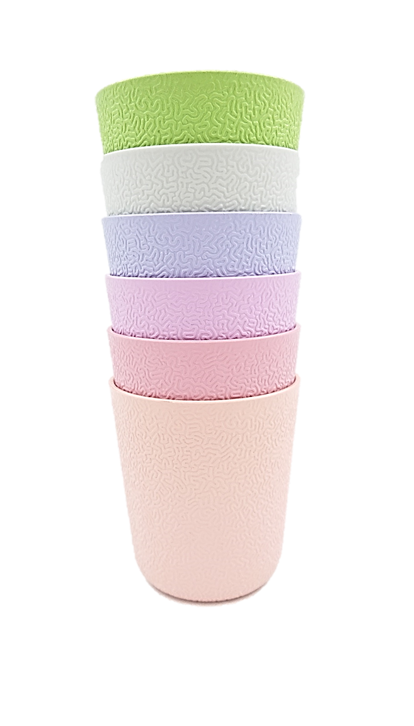
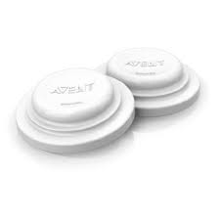
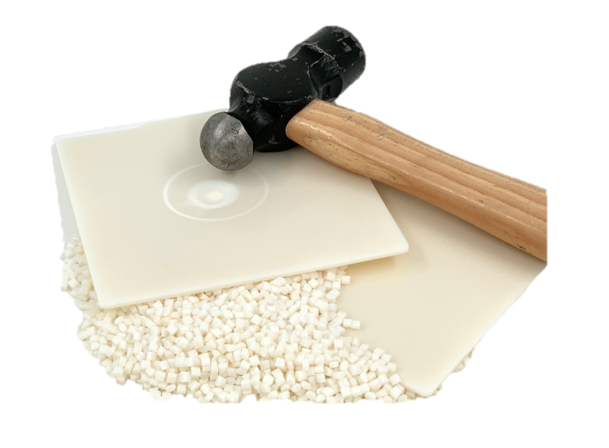
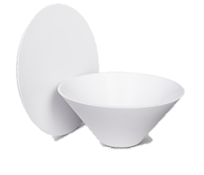
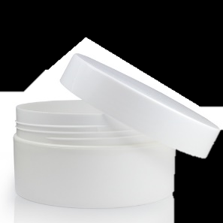
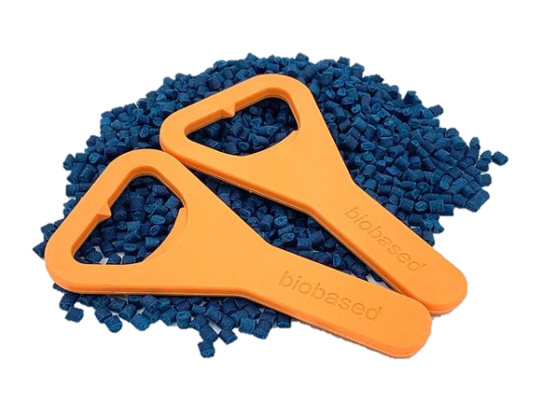
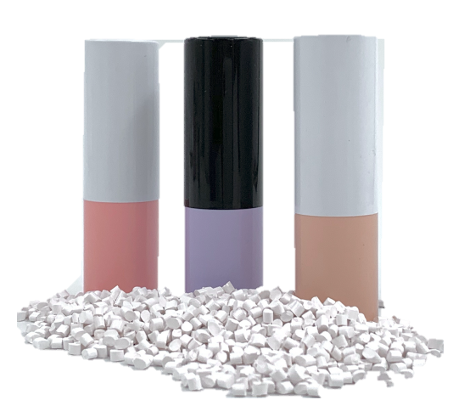
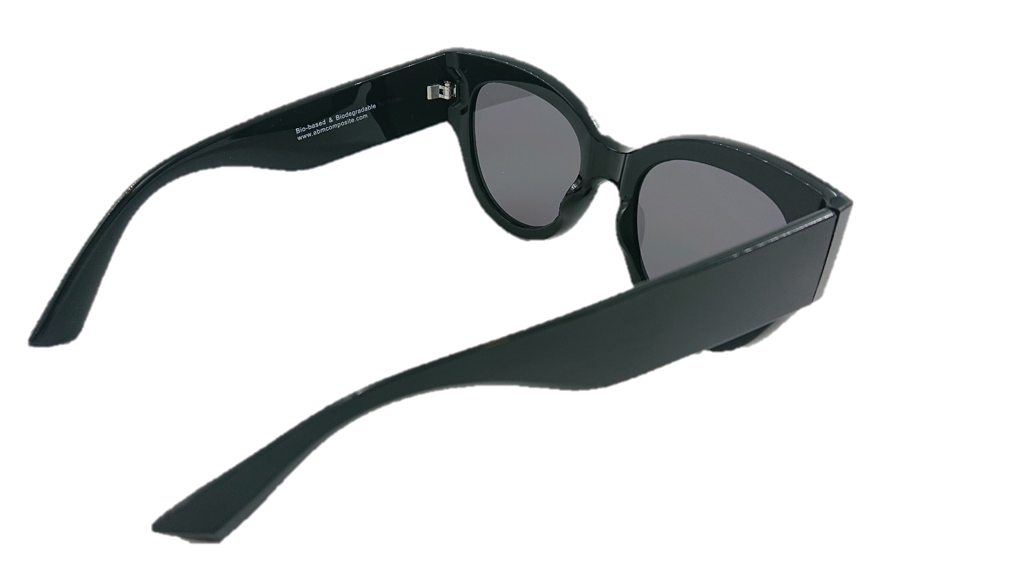
ABM TECHNICAL TARGET SEGMENTATION
Sustainable & clean alternatives for fossil plastics
Food
Industry
Personal Care
& Home

Slide 38
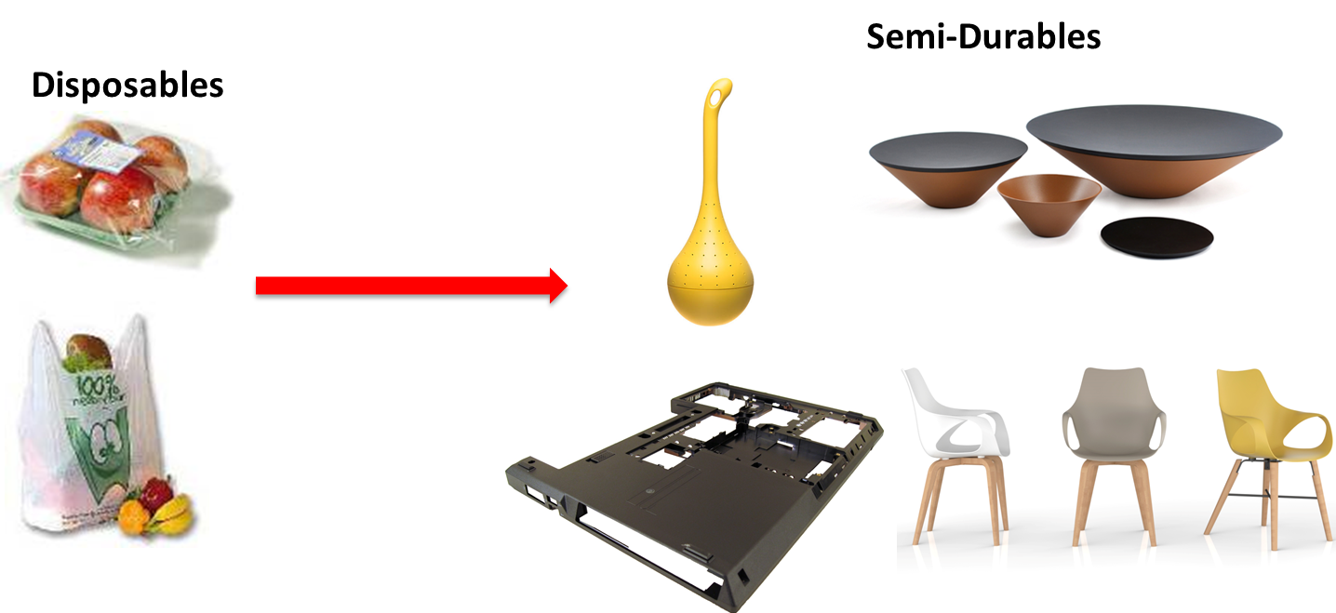
ArcBiox- Bio-based biodegradable plastics
Focus on (semi)-durable applications instead of simple disposables
Solutions for better material performance => alternatives to fossil-based commodity plastics (ABS, PP, PE)

Slide 39
ABM APPROACH
Bio-based and biodegradable polymers
39
ArcBiox Degradable glass fiber
Formulation
Performance
Functionality
Regulatory
Functional additives
COMPOUNDING
End product manufacturers
Processability
-Production speed
- preferably a drop-in
Solution
Injection molding
Sheets &thermoforming
Blow molding
SALES
Material testing
Performance

Slide 40
Polymer/additive producers
Brandowners/consumers
Polymer & functional additives
Specific material properties
Availability
Bio-based/biocontent
Biodegradable
Compostable
Processability
Requirements/
demands
down the supply chain
Product performance
Mechanical
Heat resistance
Colorability
Dishwasher resistant
Processability
Shelf-life
Arctic Biomaterials
Biocontent
Chemical compatibility
EoL (reuse vs compost)
Complies with regula-tions(eg. Food contact)
Regulatory
Price
Price

Slide 41
Bioplastics pool - Future prospects

Slide 42
Summary
Increasing production and use of fossil-based plastics and, overwhelming environmental pollution is intolarable
A ”bio-future” is inevitable
+ Functional & Sustainable bioplastic solutions available
+ Continous improvements in use of feedstocks for monomer production
+ Legislation and directives drive and support bio-based plastic solutions
- Limited availability of Material & additive fulfilling regulatory and price issues
- Collection/Recycling infrastructure is needed for circularity
- Expensive

Slide 43
Contact details
Arctic Biomaterials Oy LTD
Arvo Ylpön katu 41
33520 Tampere, Finland
info@arcticbiomaterials.com
www.abmcomposite.com
Ari Rosling (R&D Director) +358 (0)405726951
(ari.rosling@abmcomposite.com)

Slide 44
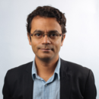

European Bioplastics Research Network
NEXT SPEAKER
Laurent Bélard
France

Slide 45


Adequacy between market expectations and possibilities
Laurent Bélard, 17/02/2021
This project has received funding from the European Union’s Horizon 2020 research and innovation programme under grant agreement
No 860407. BIOPLASTICS EUROPE project website: www.bioplasticseurope.eu

Slide 46

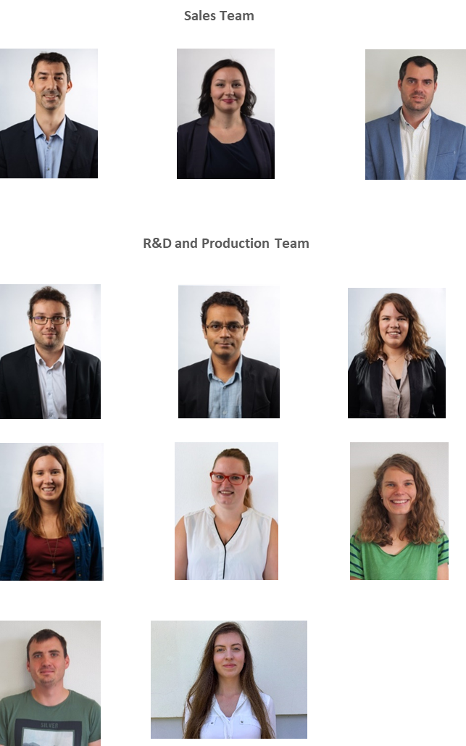
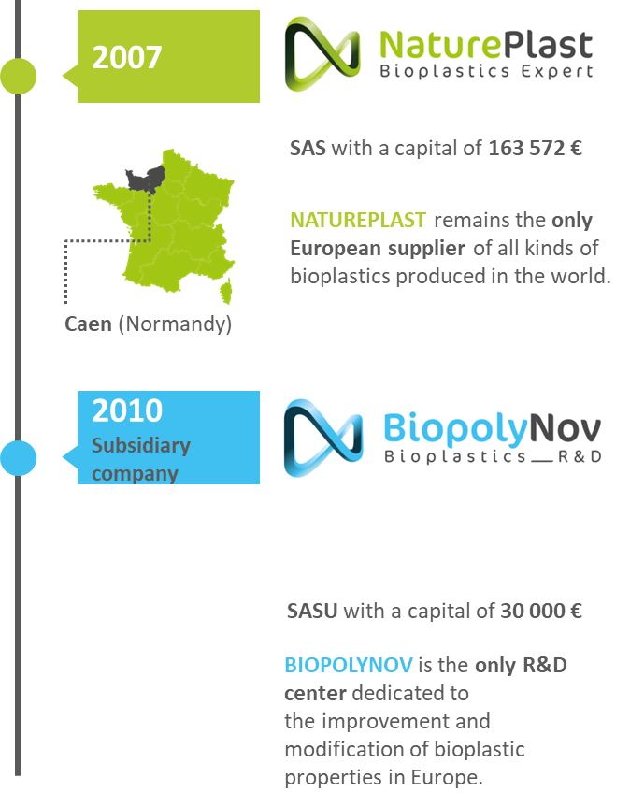
Presentation of the company:

Slide 47


Our goal
TO SUPPORT OF FRENCH AND EUROPEAN INDUSTRIES (manufacturers and end users) in the transfer of technology to bioplastics.

Slide 48




What is expected?
Most of the provided books of specification can be summarised by:
« I want the same product, but better, and cheaper »…
same product = technically equivalent
technically?
but better =
environmentally?
and cheaper = economical advantage

Slide 49

Same product…
Depending on the applications, some equivalent materials can be targeted.

Slide 50

Same product…
Material properties can be adapted if needed.

Slide 51
… but better…
Biobased : defined by standard EN 16575:2014 - Part of a product coming partially or totally from biomass (vegetal or animal). This part can represent a very variable amount within the material, no minimum amount being currently defined to use this name.
1G (food) | 2G (non food) | 3G (non food ; soil-less)
Vegetal oils: soybean, palm, sunflower, rapeseed, etc. | Lignocellulosic biomass : wood, coproducts or wastes from wood or agriculture (bagasse, straws, etc.) | Sugars or oils produced by micro-organims (algae, bacteria, mushrooms, yeasts, etc.).
Starch : corn, wheat, potato, tapioca, etc. | Inedible vegetal oils: castor oil and production wastes from other oils | Municipal wastes: organic wastes, wastewaters, etc.
Glucose : sugar cane, beetroot, etc.
Most commercially available materials are made from 1st generation resources. R&D work is currently undergoing to develop 3rd generation materials.

Slide 52





… but better…
Biodegradable : A material is biodegradable if it can be degraded through the action of microorganisms (bacteria, mushrooms, algae, etc.). The result of biodegradation is water, CO2 and/or methan and eventually by-products (residues, new biomass) non-toxic for the environment.
Biodegradation is performed under given conditions and requires time! Some materials require specific conditions to biodegrade fully and fast!! Biodegradable does not mean « throw-away »!!!

Slide 53
… and cheaper…
Biobased polymer | Availability | Price (€/kg)
PET | Good | 2 – 2,5
PE | Very high demand | 2 - 3
PP | Limited production capacities | 3
PA | Often production on request or high demand | 6 - 15
TPE (TPU, SEBS, etc.) | Often production on request | 5 - 8
PLA | Very high demand | 2,5 - 3
PHA | Limited production capacities | 6 - 8
PBS / PBSA | Very high demand | 5 - 6
Cellulose-based | Good | 4 - 6
Starch-based | Good | 3 - 4
Biobased materials remain currently more expensive than oil-based materials. Prices tend to increase slightly due to high demand, but should decrease thanks to the increase in production capacity.

Slide 54
To conclude
Wanted | Proposed
Same | Possible thanks to R&D, and material modifications
Better | Depends on what is expected: Biobased: not always fully biobased, mostly first generations available Biodegradable: should be performed in controlled and specific conditions (do not throw away unless specific uses)
Cheaper | Well…
Materials are already available and can be used for various applications. However, a perfect adequacy between expectations and reality is yet to be made, and R&D work is still needed.

Slide 55
Thank you!
You can subscribe to Bio-Plastics Europe Newsletter here: https://www.bioplasticseurope.eu/newsletter
You can contact NaturePlast through our website: http://natureplast.eu

Slide 56


European Bioplastics Research Network
NEXT SPEAKER
Patricia Aymà
Spain

Slide 57
“TECHNOLOGICAL AND MARKET RELATED CHALLENGES
TO BIO-BASED PLASTICS PRODUCTION”
PANEL DISCUSSION
Follow us on social media
BIO-PLASTICS EUROPE website: https://bioplasticseurope.eu/
European Bioplastics Research Network
This project has received funding from the European Union’s Horizon 2020 research and innovation programme under grant agreement No. 860407

Slide 58
“TECHNOLOGICAL AND MARKET RELATED CHALLENGES
TO BIO-BASED PLASTICS PRODUCTION”
Thank you for joining us!
Follow us on social media
BIO-PLASTICS EUROPE website: https://bioplasticseurope.eu/
European Bioplastics Research Network
This project has received funding from the European Union’s Horizon 2020 research and innovation programme under grant agreement No. 860407

